Slide 1
Fourth avenue reconstruction
Presentation by the Downtown Development Authority (DDA) for the Commission on disability issues
November 19, 2025

Slide 2
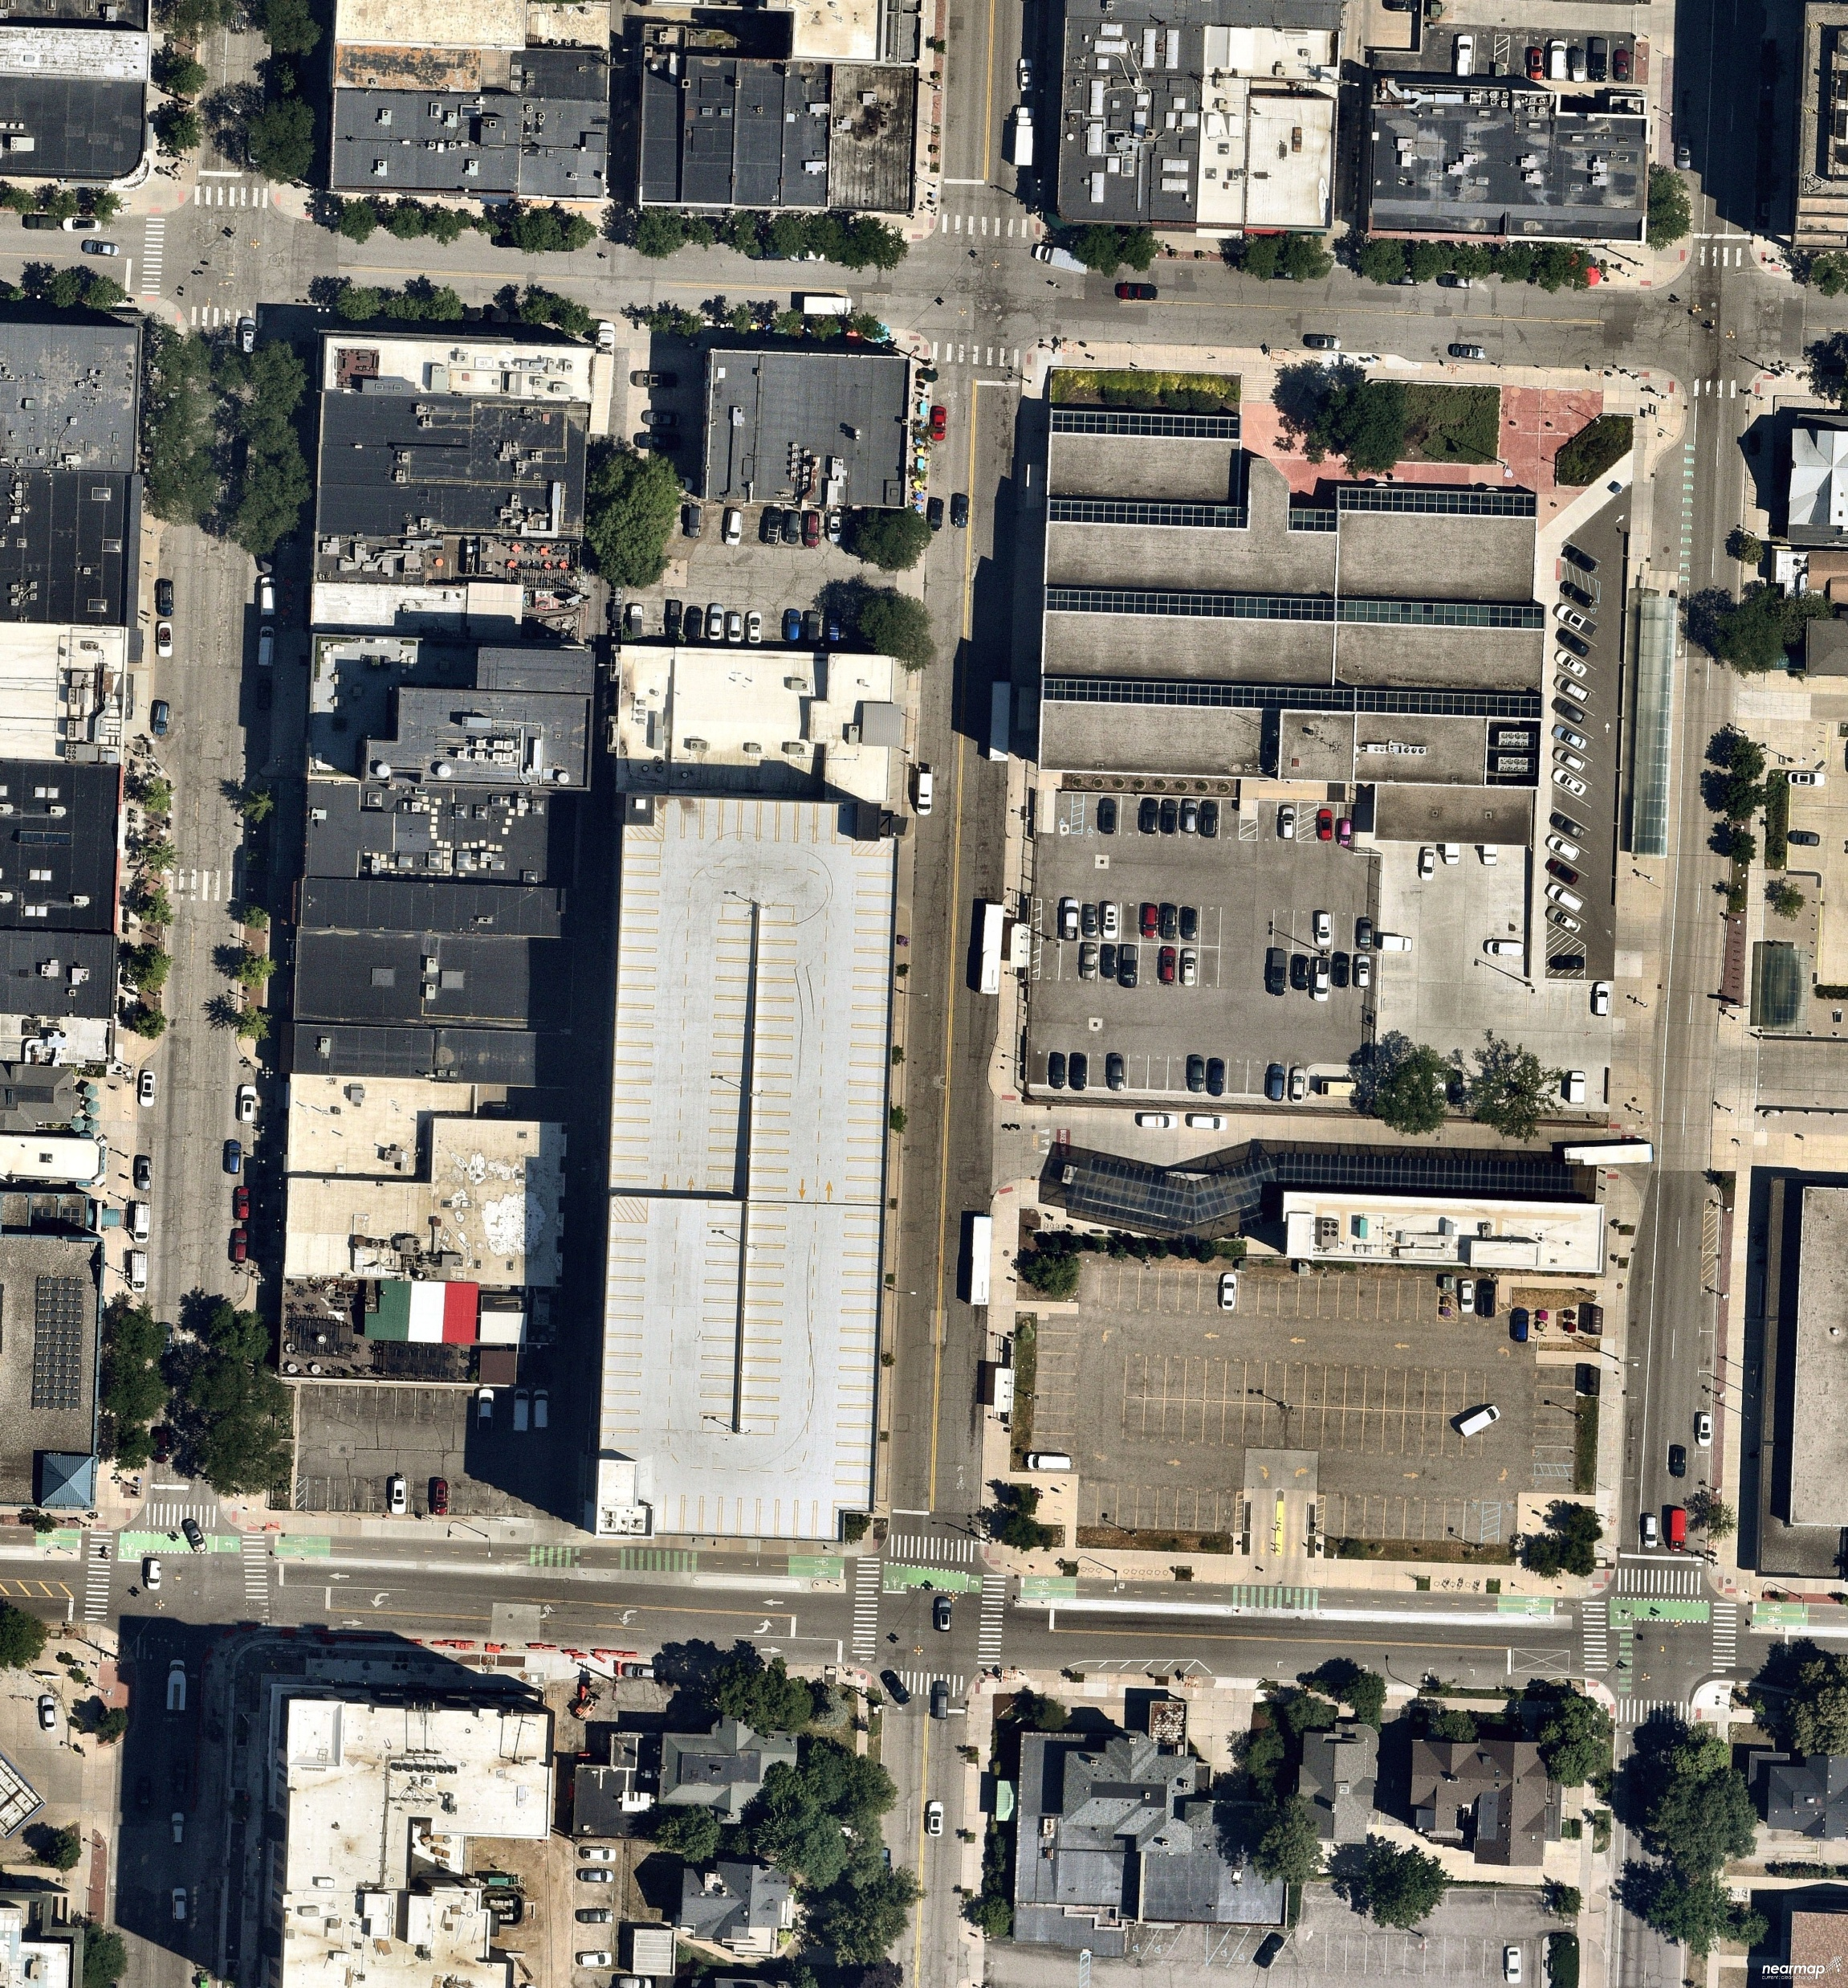
Project boundary
E. Liberty Street
E. William Street
Parking Structure
S. FOURTH AVE.
350
S. Fifth Ave.
Blake Transit Center
Federal Building
The project area includes Fourth Avenue from William Street to Liberty Street, excluding the William intersection but including the Liberty intersection.

Slide 3
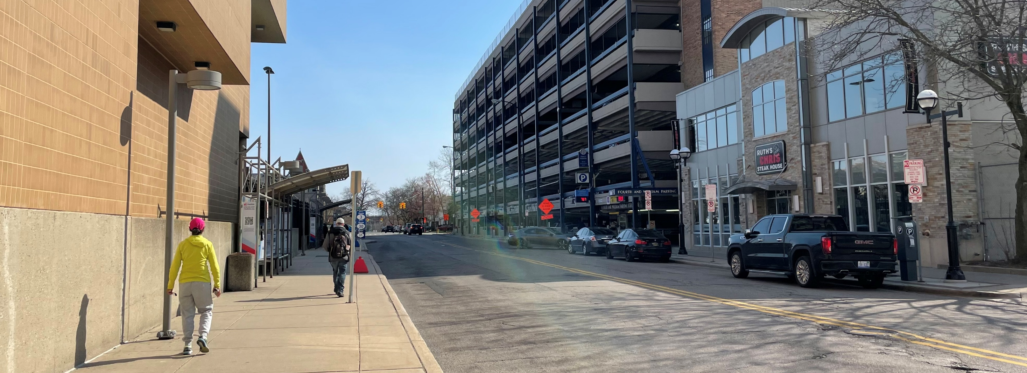
Existing conditions
The project area of Fourth Avenue abuts the Blake Transit Center, Federal Building, Fourth & William Parking Structure, and two restaurants. The area has narrow sidewalks, small bus shelters, and undefined travel lanes. The areas also has high pedestrian traffic due to the Transit Center.

Slide 4
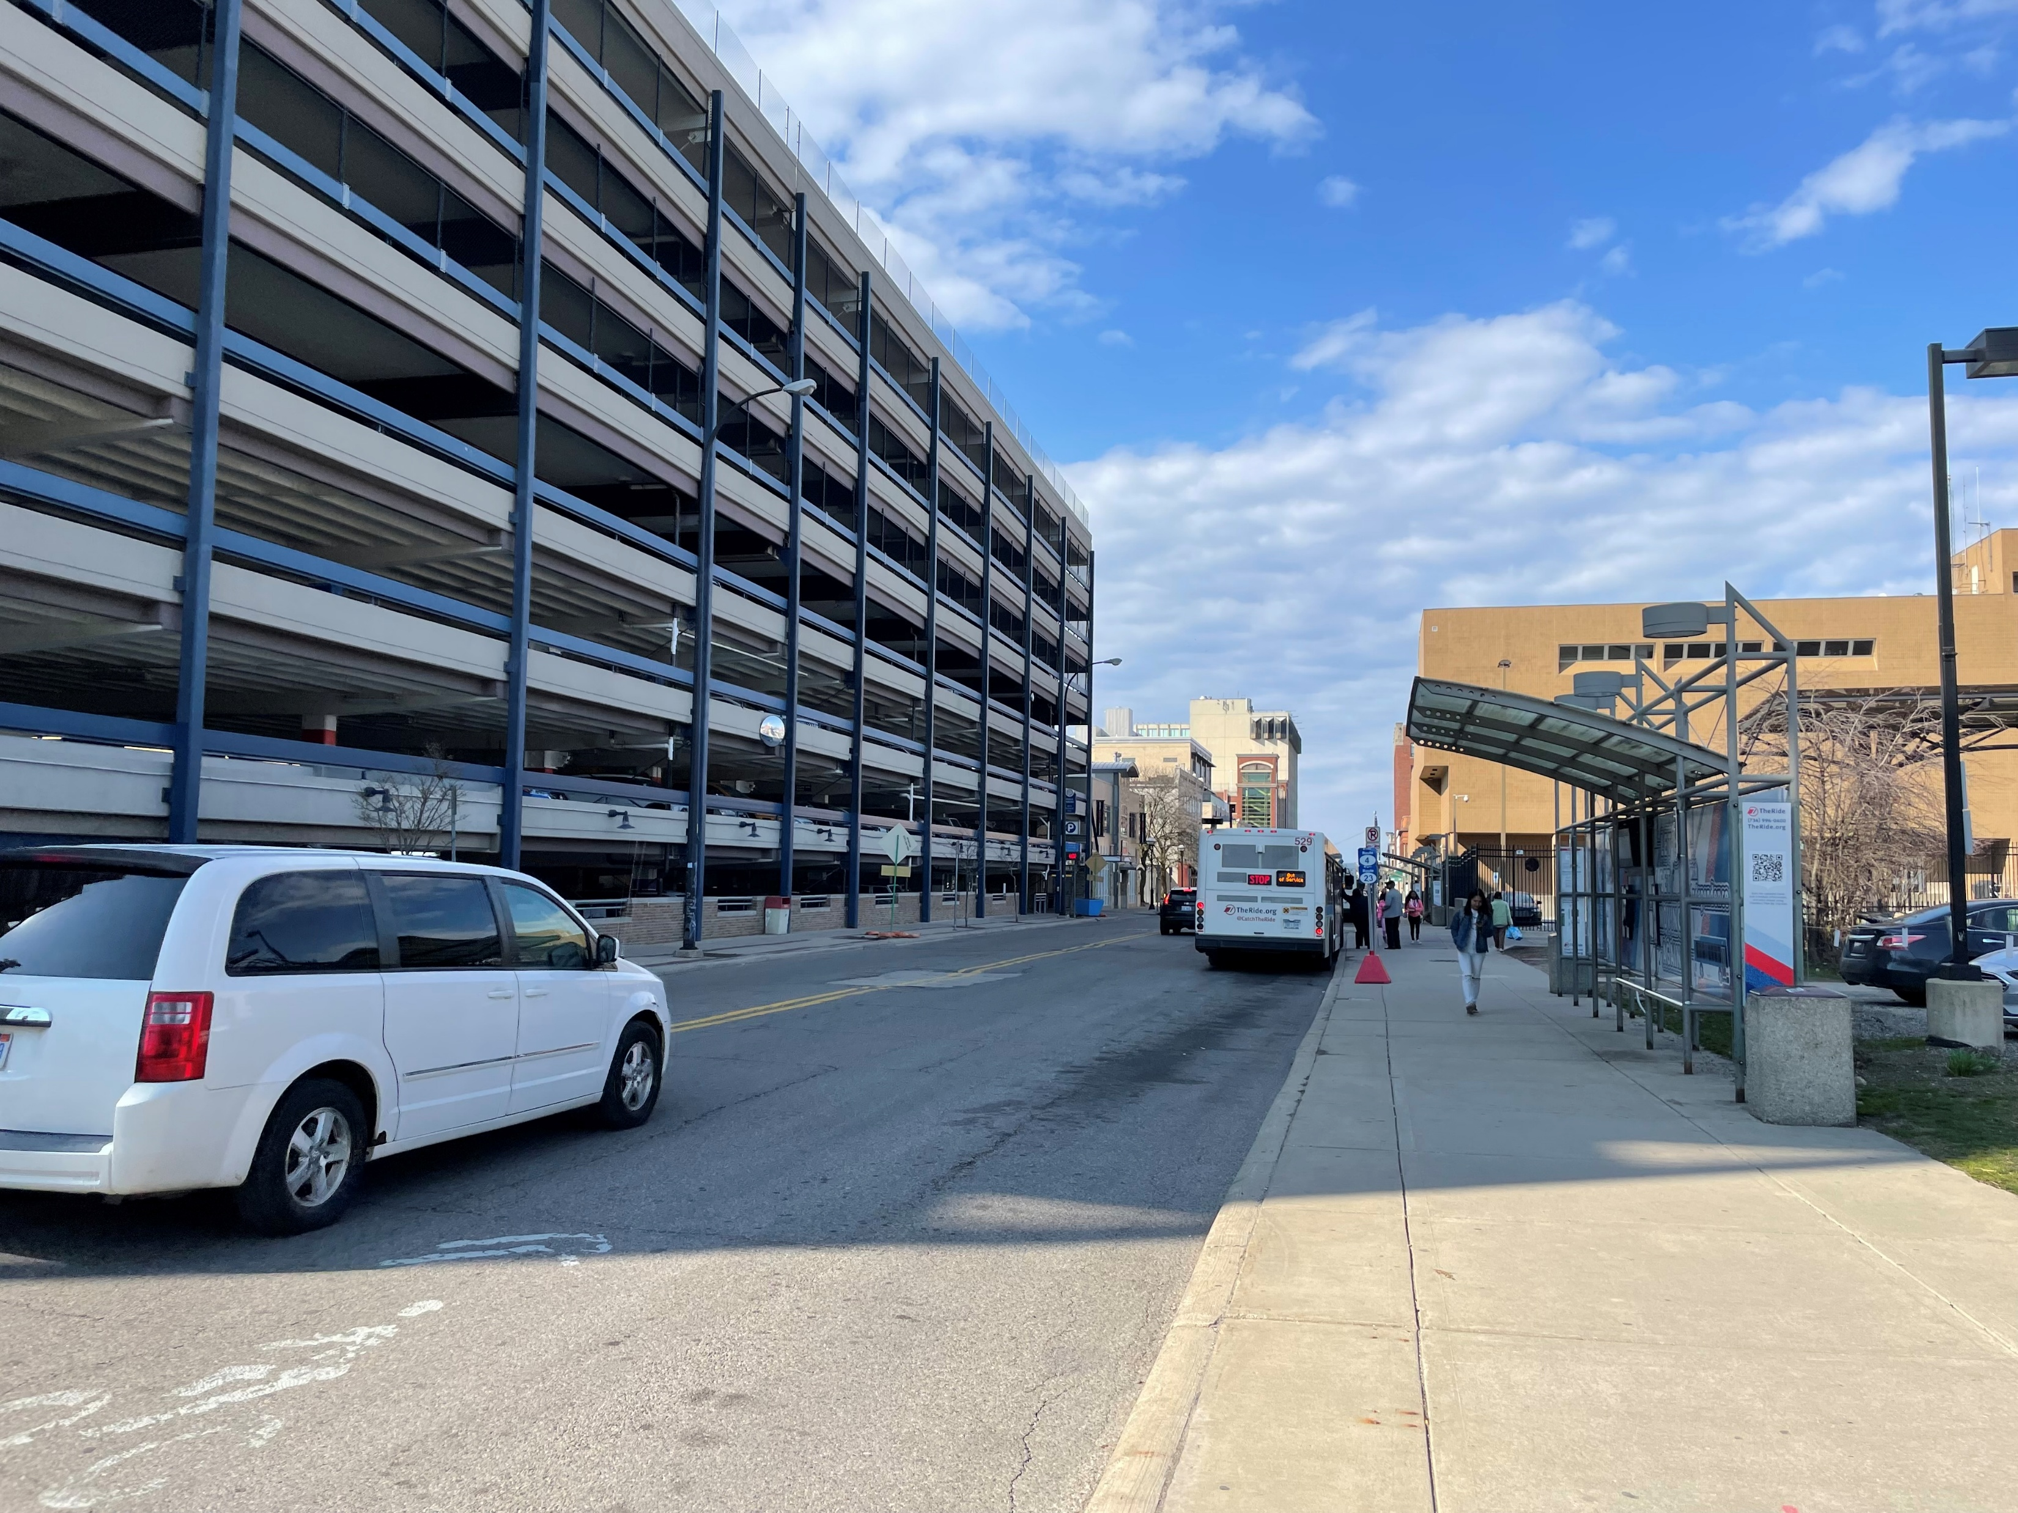
Project goals
With this project, the DDA aims to:
Improve safety and comfort for all users.
Create a street that functions as an extension of the Blake Transit Center.
Support the future affordable housing development at 350 South Fifth Avenue (located on the former YMCA lot).
Visually link the block with the “downtown feel” on Liberty Street.

Slide 5
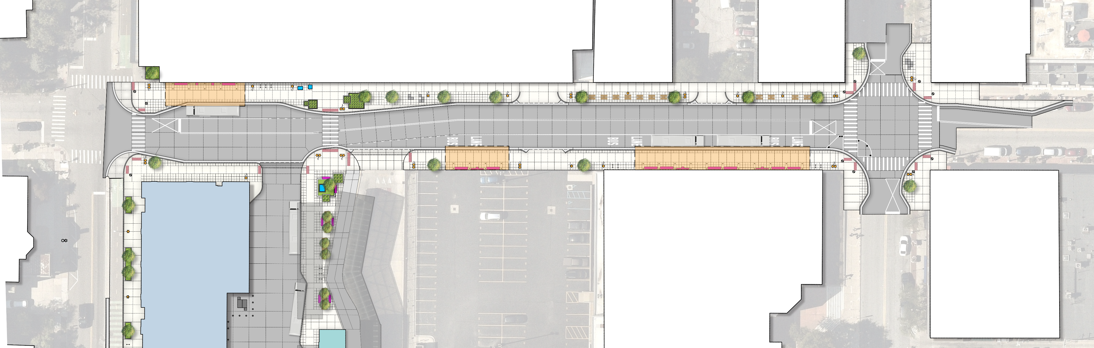
Overall Streetscape design
Parking Structure
NORTH
S. Fourth Ave.
E. William Street
350
S. Fifth Ave.
Blake Transit Center
Federal Building
E. Liberty Street
The proposed plan includes wider sidewalks, large bus shelters, defined bus lanes, new lighting, street trees, and safer crossings. Additionally, a new mid-block crosswalk is planned next to the Blake Transit Center.

Slide 6
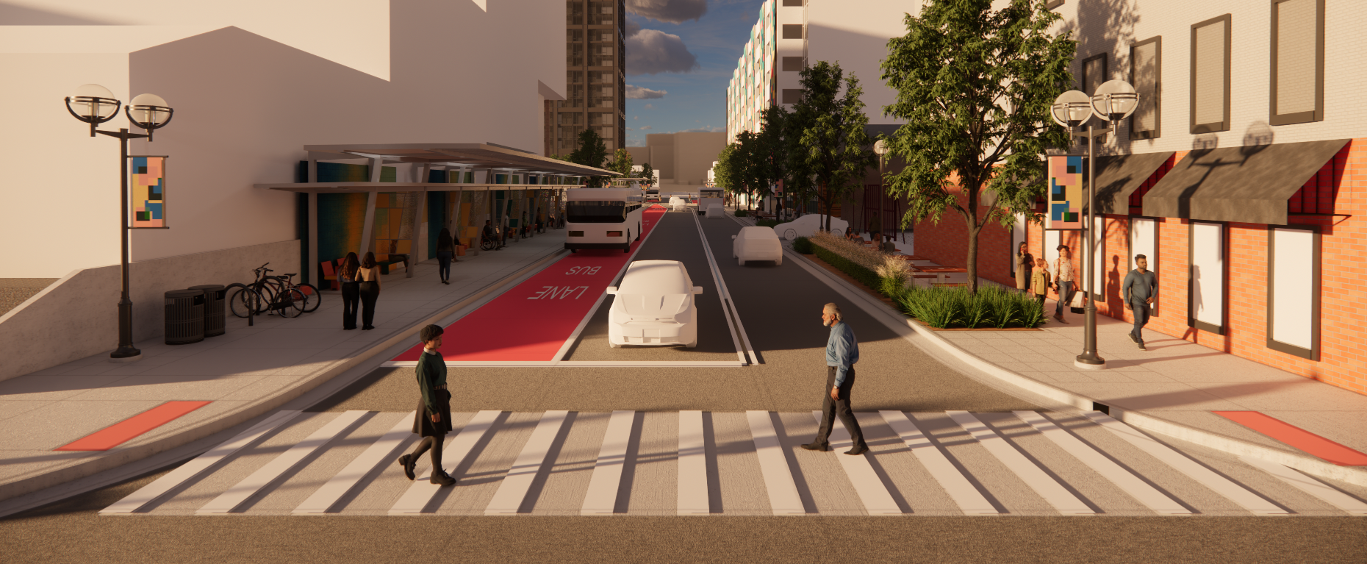
Proposed Streetscape Rendering - South
Rendering 1: Future view of Fourth Avenue looking south from Liberty Street. Features include new trees, benches, bike parking, and bus shelters.

Slide 7
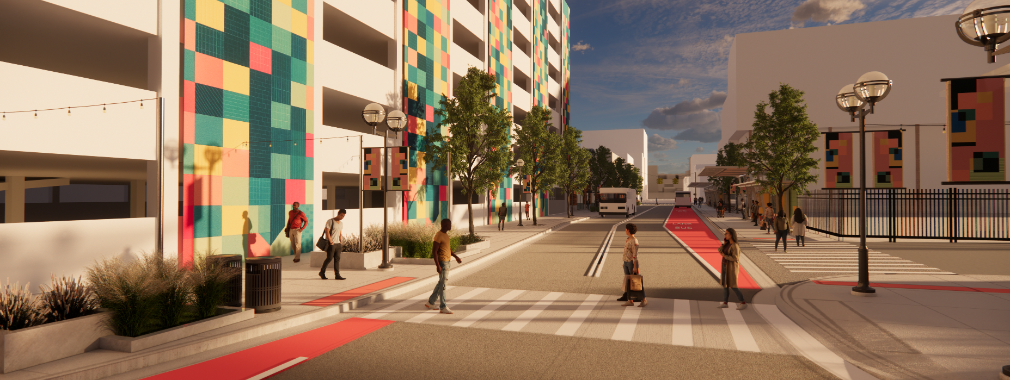
Proposed Streetscape Rendering - North
Rendering 2: Future view of Fourth Avenue looking north from the mid-block crossing at the Blake Transit Center. Features include landscape planters, designated bus lanes, and public art.

Slide 8
Tactile Paver Focus Areas
Parking Structure
NORTH
AREA 1
AREA 2
S. Fourth Ave.
E. William Street
350
S. Fifth Ave.
Blake Transit Center
Federal Building
E. Liberty Street
There are two focus areas where we would like feedback on the proposed tactile pavers.
Focus Area 1 encompasses the mid-block crosswalk on both the east and west sides of Fourth Avenue.
Focus Area 2 encompasses the driveway entrances to the parking structure and the Federal Building.

Slide 9
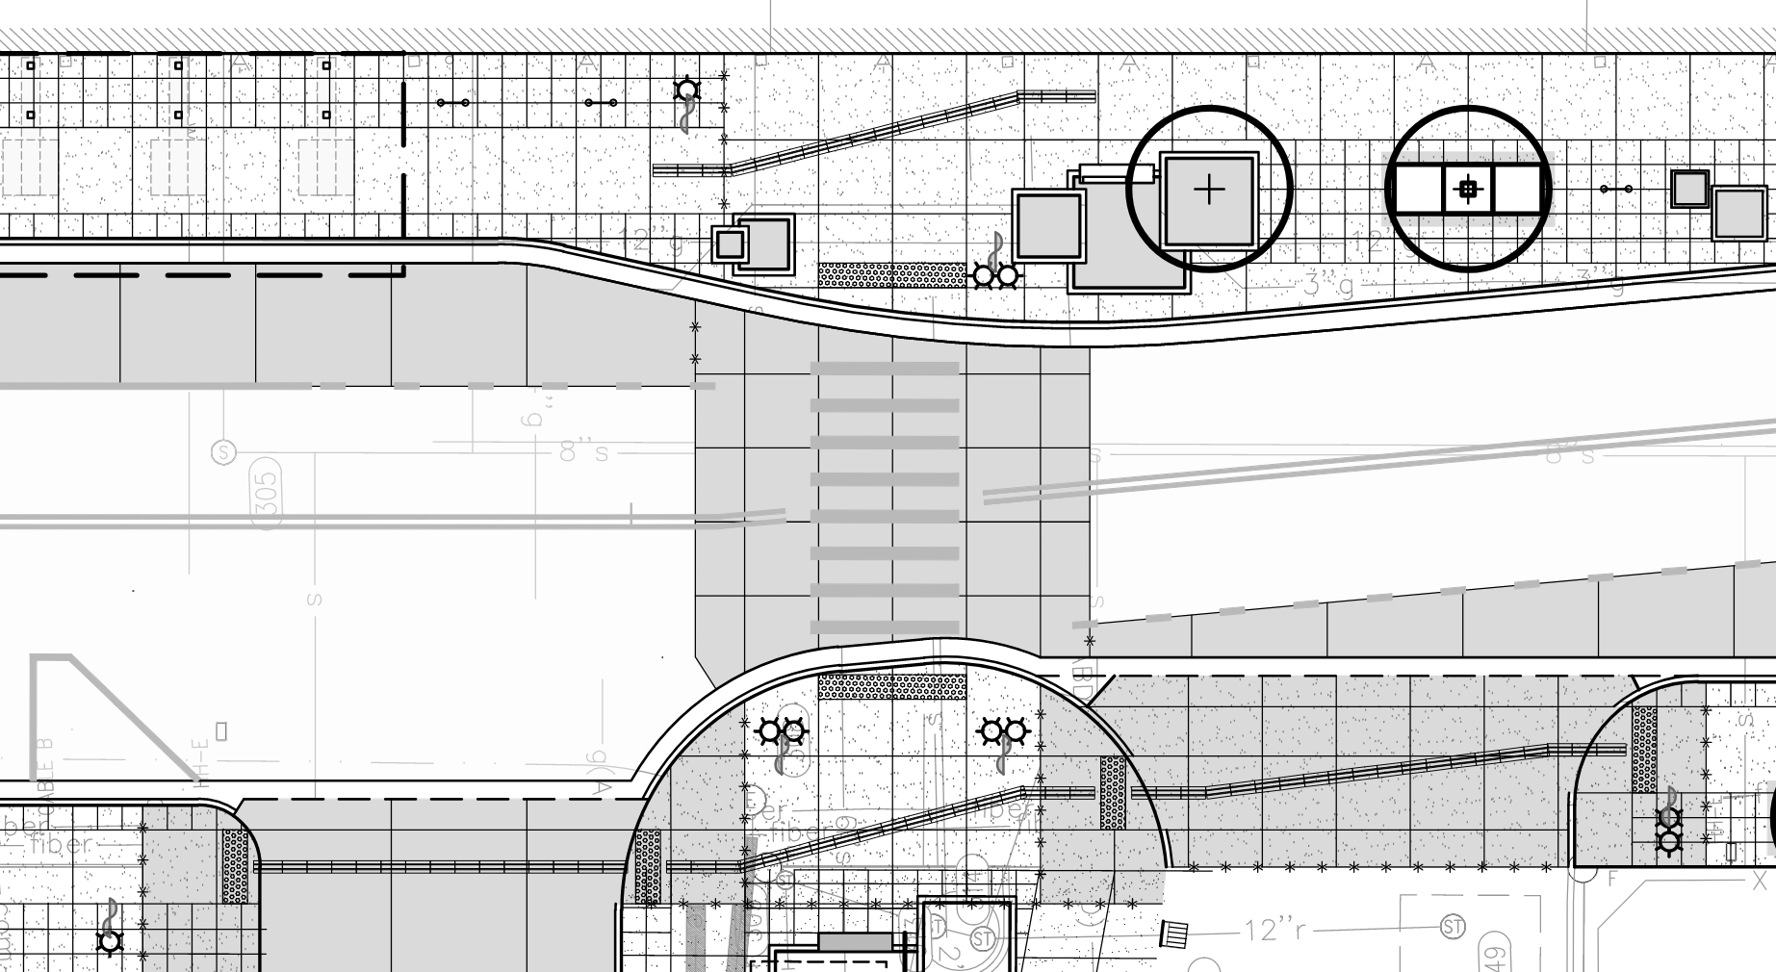
Focus Area 1: Mid-Block Crosswalk
3
Proposed tactile elements:
Domed warning plates at the approaches to all existing and proposed driveways to the Blake Transit Center, and at the mid-block crosswalk.
Directional tiles along the centerline of the walking path to guide users across both driveways.
Directional tiles along the centerline of the walking path where it jogs/shifts adjacent to the mid-block crossing.
1
1
S. Fourth Ave.
2
2
3
New BTC Driveway
Existing BTC Driveway

Slide 10
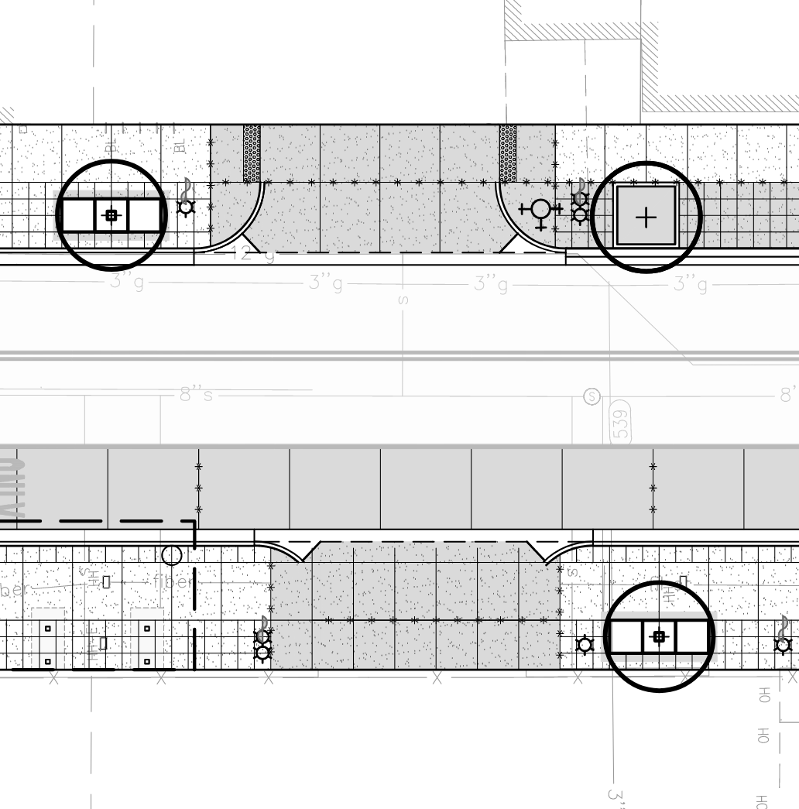
Focus Area 2: Driveways
Parking Structure Driveway
Driveway features:
Proposed tactile warning plates at the Fourth & William Parking Structure driveway. This driveway is controlled with a gate arm. The proposed design meets the intent of the Public Right of Way Accessibility Guidelines.
Tactile warning plates are not required at Federal Building driveway, per the Public Right of Way Accessibility Guidelines. This driveway does not have a controlled stop and is not used frequently.
1
1
S. Fourth Ave.
2
2
Gated Federal Building Driveway

Slide 11
THANK YOU

